Slide 1

Clique – A Celebration Of Sharing Happiness

Slide 2











Clique – An Opportunity under Truevibez Umbrella
Clique is premium service offered to our finest customers & business partners, to mutually benefit through means of microfinancing services.
Dine Now, Pay Later
For customer expecting an event to visit restaurant but without available liquid funding, Clique will open up a line of credit in handshake with a lender (NBFC). The customer can request this restaurant-focused credit line and once approved, use it at any partner restaurant.
Merchant Staff Financial Lending
Restaurant staff currently face many challenges in requesting loans from banks and NBFCs however from recommendation of a partner merchants, a low-medium size credit pool will be made available to them with flexible repayment options.
With microfinance market anticipated to grow with CAGR of 40% through 2025, NBFC-MFIs will be its greatest beneficiaries. In F&B segment, unbanked microlending has only reached 12-15% of the prospective market.

Slide 3
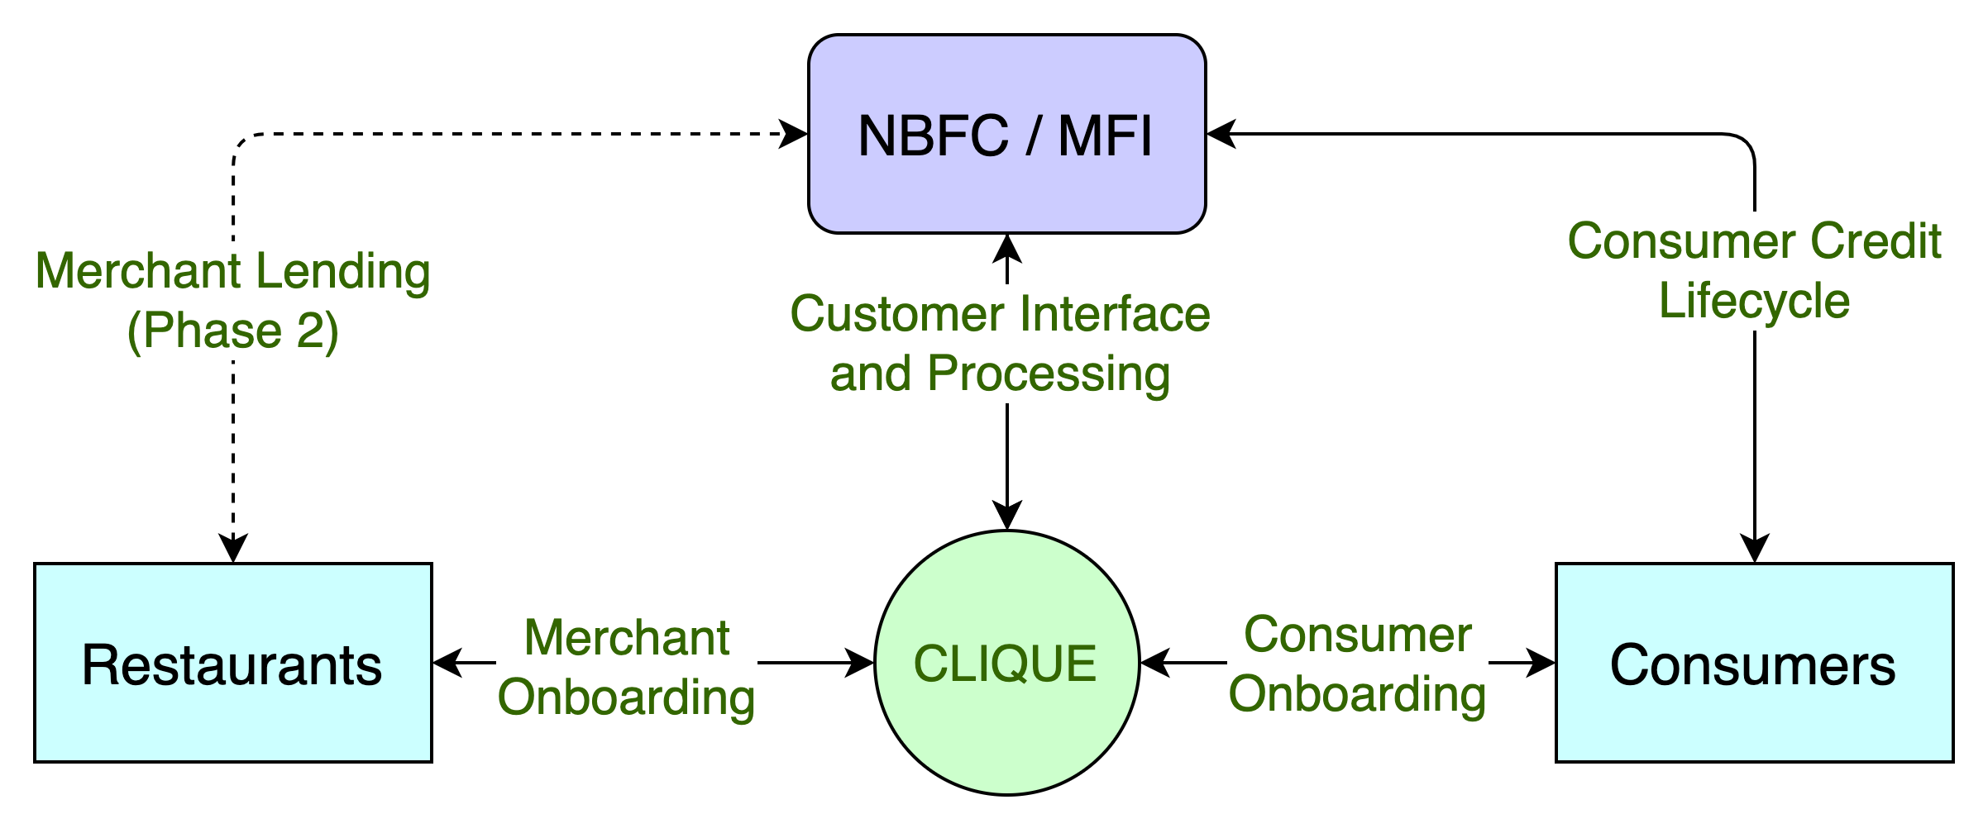
Clique – High Level System Flow

Slide 4
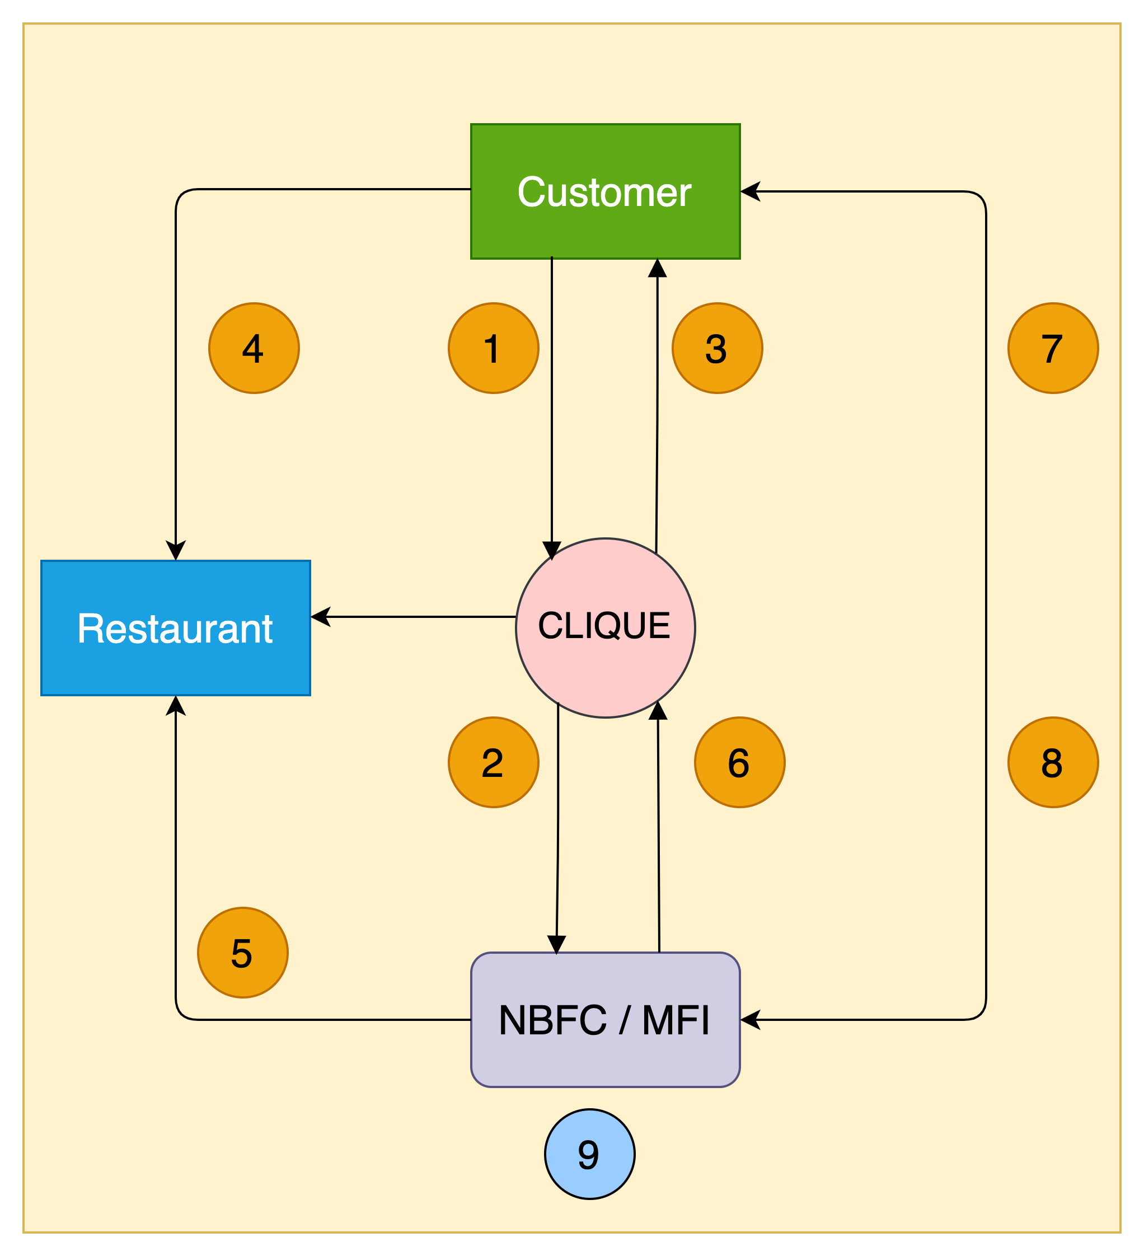
Clique – High Level Transaction Process Flow
1. Customer walks into a restaurant & applies for the wallet credit through Clique App
2. Clique receives customer application & send it to the lender for underwriting & respond with approval or rejection
3. Customer app wallet is credited with approved funds & signs NACH mandate
4. Customer utilises the wallet credit at the restaurant e.g., Rs 5000
5. Lender pays the merchant (less the operational charges) based on merchant's billing cycle e.g., Rs 4000
6. Lender pay the commission to Clique e.g., Rs 800 based on payment reconciliation, on agreed frequency
7. Customer pays lender later based on agreed T&C,
including interests, delay charges etc.
8. Once paid, even if partially, lender updates Clique to reset
customer’s wallet for calculated funds for further utilisation
9. Lender keeps the balance i.e., Rs 200, for their services

Slide 5
Clique – Customer Onboarding Journey
02
Customer reviews standees, flyers, tent cards and informed by staff about Clique
03
Customer downloads Clique app and completes KYC application
01
Customer walks into
a restaurant
Clique routes the application to lender
06
Lender sends a confirmation back to Clique
04
05
Lender underwrites the customer
07
Clique updates customer app and reflects the wallet credits
08
Customer enjoys the F&B services
09
Customer pays through clique credit & returns home

Slide 6
Clique – Main Apps & Backend
Customers App: For public end users - Reference – Dineout, Zomato, Swiggy apps
Customer registration, data capture and profiling based on taste, location & shows nearby restaurants, facilities, menus etc.
Top deals, featured services, option to search based on choice e.g. Parsi cuisine, live music, dog friendly etc.
Link to apply for credit line showing multiple lenders. Similar to how payment options like card, cash, simpl, Lazypay etc. are show on Zomato app, only instead of these, the options will be of lenders like Lazypay, paytm, bajaj etc.
Wallet service based on lent funds, utilized & available funds, pending dues, transaction history, push notifications etc.
Scanner to scan restaurant QR code for wallet transfer and ribbon for latest offers, deals, what's-on
Merchant App: For restaurant managers/owners - Reference – Dineout, Zomato, Swiggy’s restaurant side apps
To have restaurant specific QR code to accept payments
Merchant wallet and option to pay back to customer in case of accidental/incorrect transfers
Customer care contact, guest data capture & contact
Admin (backend): For Clique administrators, merchants and merchant staff
Admins: User management, data access, reporting, settlement matrix, financials, corporate partner management, tracking, master controls
Merchants: Setup (info, menus, pricing, photos), reporting, activation/deactivation, discount codes, order tracking, push notification settings,
Staff: Setup, profile, loan application with documentation transfer to lender, status, repayment plan
Website: Business website for informational purposes - Reference – Dineout
- One Page website to inform about the services of Clique, pics, videos, top merchants, offers, app download links etc.

Slide 7
Phases & Scope
Phase 1. Proof Of Concept : For investor pitch demonstration
Target Date: 14th Feb 2022
Basic apps with production look & feel and ease of usage
Integration with at least one/first lender tested with completed transaction tests
4-5 restaurant & customer setup completed
Must allow immediate customer setup and end to end credit transaction lifecycle
Staff lending with one/first lender to be done in real-time
Phase 2. Minimum Viable Product : For public launch
Target Date: March 2022
Completed app and backend as requested
Web portal can be a fast follower if needed
Beta testing and soft launch, followed by final launch

Slide 8





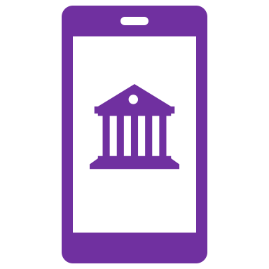

PAYO (Australia) – A case study
About PAYO
PAYO is an Australian company who have launched the world’s first Eat Now, Pay Later service in July 2021.
The are backed by an existing lender with substantial customer base in the operational regions.
Being the World’s first ENPL app, they have favorably placed themselves as market disrupters, driving investor’s interest & confidence.
Within 3 months of launch, 700+ merchants in 4 cities & growing at the pace of 200 merchants every month
All payments are divided across 4 interest free EMIs, with only a quarter of payment to be made upfront.
Top performing 50 restaurants have received thousands of transactions with recorded order value increase of 60%
Diners can discover restaurants, filter by preferences, call restaurant, book table and receive range of offers & deals.
Both restaurants & customers are incentivized for referring more paying users to the platform
All payments are via PAYO app via QR codes with options for customer to recommend for PAYO business
Instant approval & discreet process has given PAYO an edge over other modes of payments, eliminating need to carry wallets

Slide 9






Question & Answers

